Slide 1
Week 2:
Basic Probability

Slide 2
OUTLINE
Review of set theory
Assigning and determining probabilities
Properties of the probability function
Probabilities for continuous sample spaces
Probabilities for finite sample spaces
Combinatorics
Binomial probability law
Real-world example: quality control

Slide 3
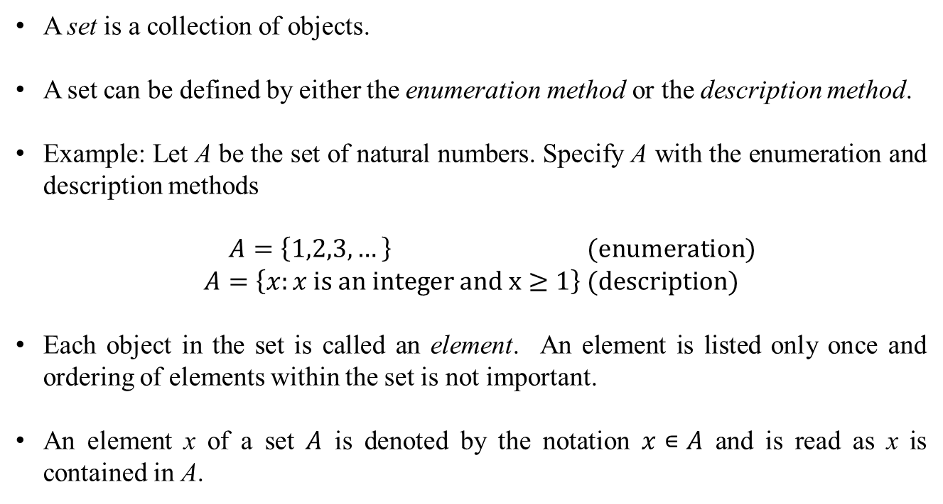
Review of Set Theory
A set is a collection of objects.
A set can be defined by either the enumeration method or the description method.
Example: Let A be the set of natural numbers. Specify A with the enumeration and description methods
$A=\left\{1,2,3,…\right\} \text{(}\text{enumeration}\text{)}$
$$A=\left\{x:x \text{is} \text{an} \text{integer} \text{and} \text{x}≥1\right\} \text{(}\text{description}\text{)}$$
Each object in the set is called an element. An element is listed only once and ordering of elements within the set is not important.
An element x of a set $A$ is denoted by the notation $x∊A$ and is read as x is contained in A.

Slide 4
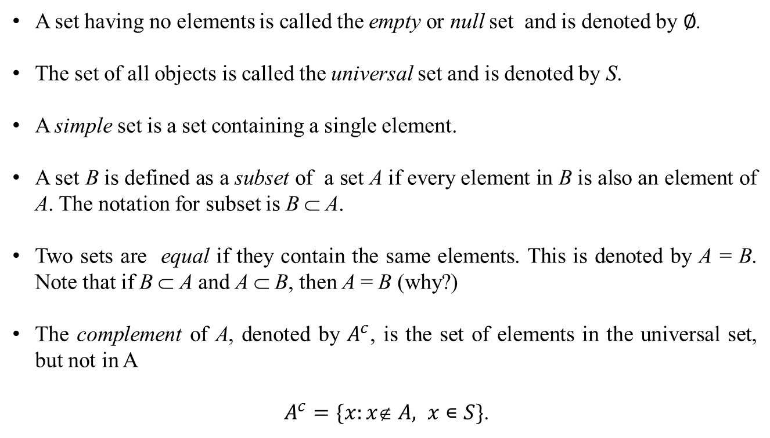
Review of Set Theory
A set having no elements is called the empty or null set and is denoted by $∅$.
The set of all objects is called the universal set and is denoted by S.
A simple set is a set containing a single element.
A set B is defined as a subset of a set A if every element in B is also an element of A. The notation for subset is B ⊂ A.
Two sets are equal if they contain the same elements. This is denoted by A = B. Note that if B ⊂ A and A ⊂ B, then A = B (why?)
The complement of A, denoted by $A^{c}$, is the set of elements in the universal set, but not in A
$A^{c}=\{x:x A, x∊S\}$.

Slide 5
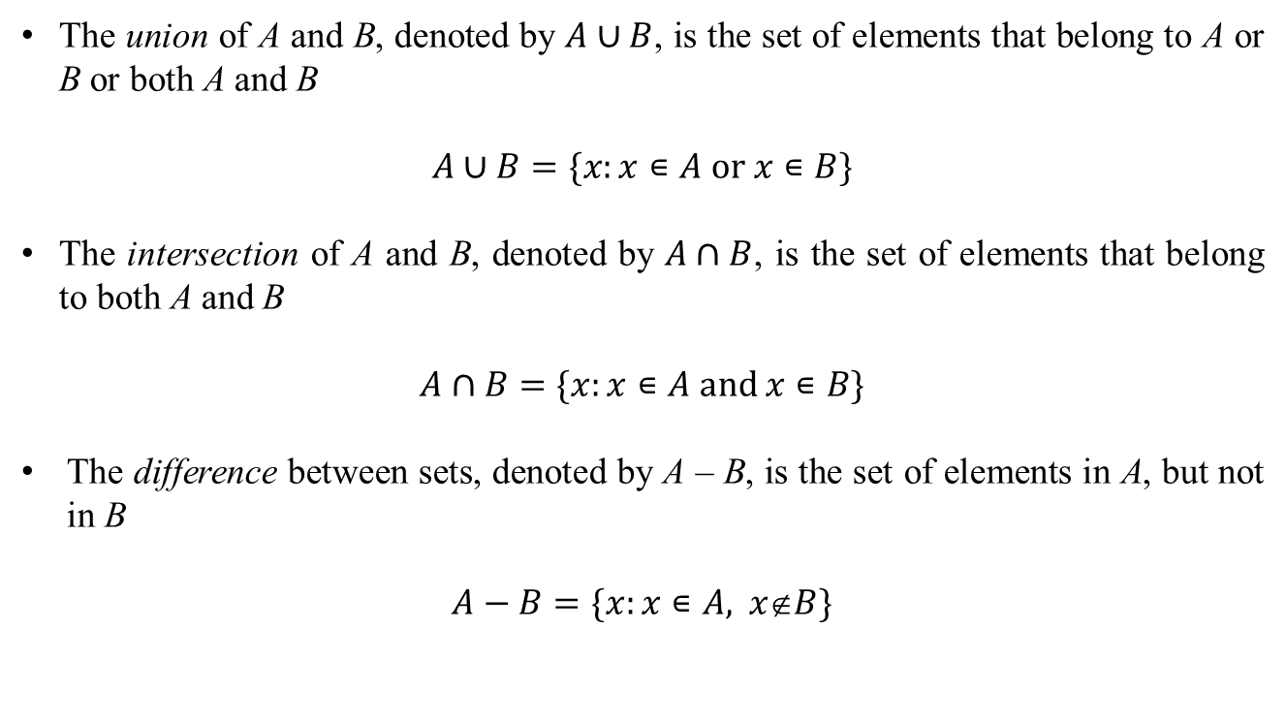
Review of Set Theory
The union of A and B, denoted by $A∪B$, is the set of elements that belong to A or B or both A and B
$$A∪B=\{x:x∊A \text{or} x∊B\}$$
The intersection of A and B, denoted by $A∩B$, is the set of elements that belong to both A and B
$$A∩B=\{x:x∊A \text{and} x∊B\}$$
The difference between sets, denoted by A – B, is the set of elements in A, but not in B
$$A−B=\{x:x∊A\text{, } x∉B\}$$

Slide 6
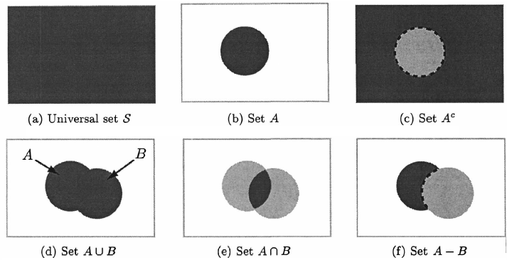
Review of Set Theory
Operations on sets can be illustrated pictorially using a Venn diagram.
Figure source: S. M. Kay, Intuitive Probabilty and Random Processes Using MATLAB, Prentice Hall, 2006.

Slide 7
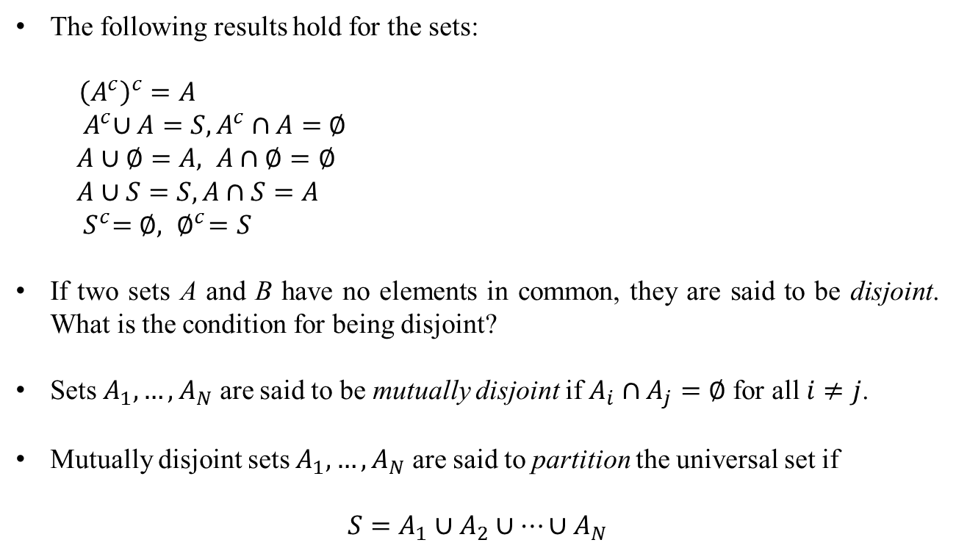
Review of Set Theory
The following results hold for the sets:
${\left(A^{c}\right)}^{c}=A$
${ A}^{c}∪A=S, A^{c}∩A=$ $∅$
$A∪$ $∅=A, A∩∅=∅$
$$A∪S=S, A∩S=A$$
$${ S}^{c}=∅,{ ∅}^{c}=S$$
If two sets A and B have no elements in common, they are said to be disjoint. What is the condition for being disjoint?
Sets $A_{1},…,A_{N}$ are said to be mutually disjoint if $A_{i}∩A_{j}=∅$ for all $i≠j$.
Mutually disjoint sets $A_{1},…,A_{N}$ are said to partition the universal set if
$$S=A_{1}∪A_{2}∪…∪A_{N}$$

Slide 8
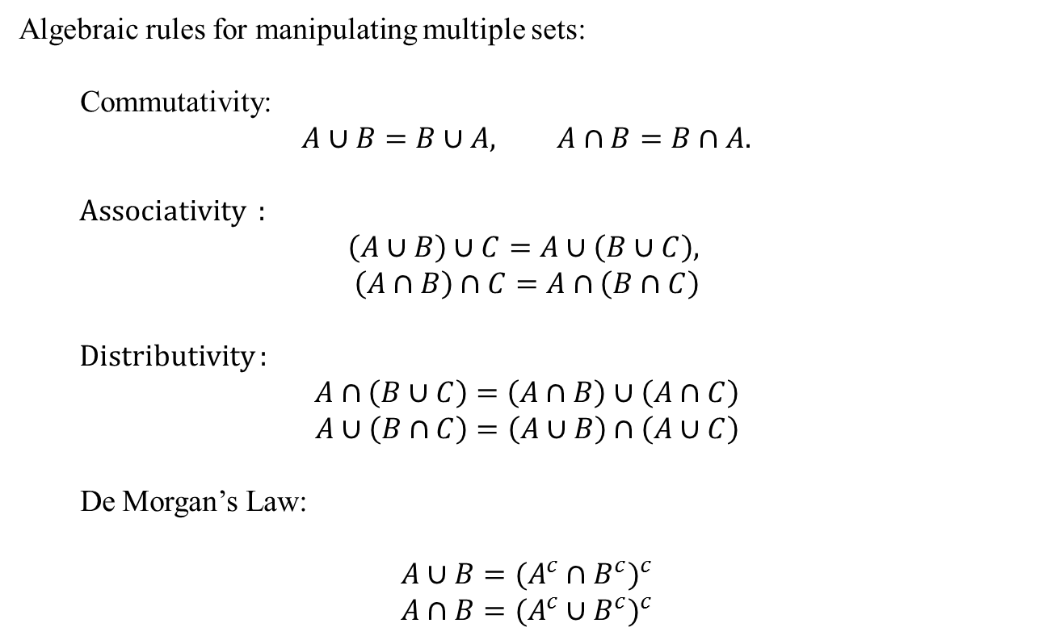
Review of Set Theory
Algebraic rules for manipulating multiple sets:
Commutativity:
$$A∪B=B∪A, A∩B=B∩A.$$
Associativity :
$$\left(A∪B\right)∪C=A∪\left(B∪C\right),$$
$$\left(A∩B\right)∩C=A∩\left(B∩C\right)$$
Distributivity :
$$A∩\left(B∪C\right)=\left(A∩B\right)∪\left(A∩C\right)$$
$A∪\left(B∩C\right)=\left(A∪B\right)∩\left(A∪C\right)$
De Morgan’s Law:
$$A∪B={(A^{c}∩B^{c})}^{c}$$
$$A∩B={(A^{c}∪B^{c})}^{c}$$

Slide 9
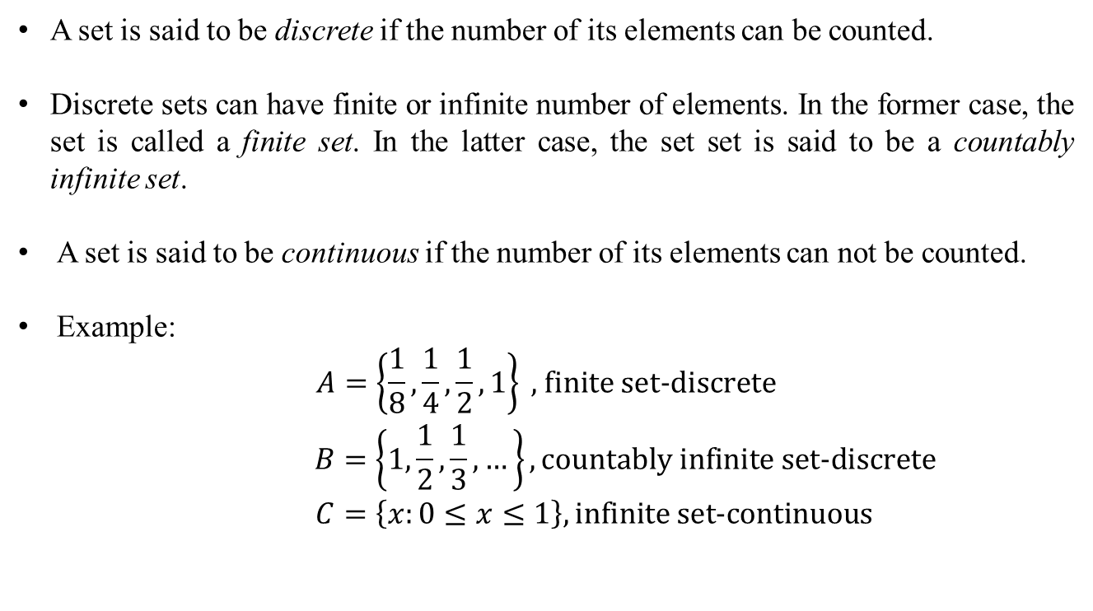
Review of Set Theory
A set is said to be discrete if the number of its elements can be counted.
Discrete sets can have finite or infinite number of elements. In the former case, the set is called a finite set. In the latter case, the set set is said to be a countably infinite set.
A set is said to be continuous if the number of its elements can not be counted.
Example:
$$\begin{matrix}A=\left\{\frac{1}{8},\frac{1}{4},\frac{1}{2},1\right\} \text{, }\text{finite} \text{set}\text{−}\text{discrete} \\ B=\left\{1,\frac{1}{2},\frac{1}{3},…\right\},\text{countably} \text{infinite} \text{set}\text{−}\text{discrete} \\ C=\left\{x:0≤x≤1\right\},\text{infinite} \text{set}\text{−}\text{continuous}\end{matrix}$$

Slide 10
Assigning and Determining Probabilities
The universal set is termed the sample space and its elements are the outcomes or the sample points.
A subset of the sample space is termed an event. Special events are
simple events: events containing only a single outcome
certian event: the sample space
impossible event: the null set
Two events are said to be mutually exclusive if both events can not occur simultaneously.
Conclusion: Probabilistic questions can be formulated using the set theory with its own terminology. Equivalent terms are given below in a table.

Slide 11
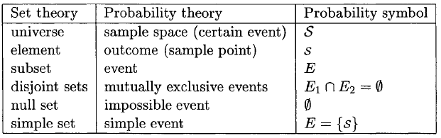
Assigning and Determining Probabilities
Table source: S. M. Kay, Intuitive Probabilty and Random Processes Using MATLAB, Prentice Hall, 2006.

Slide 12
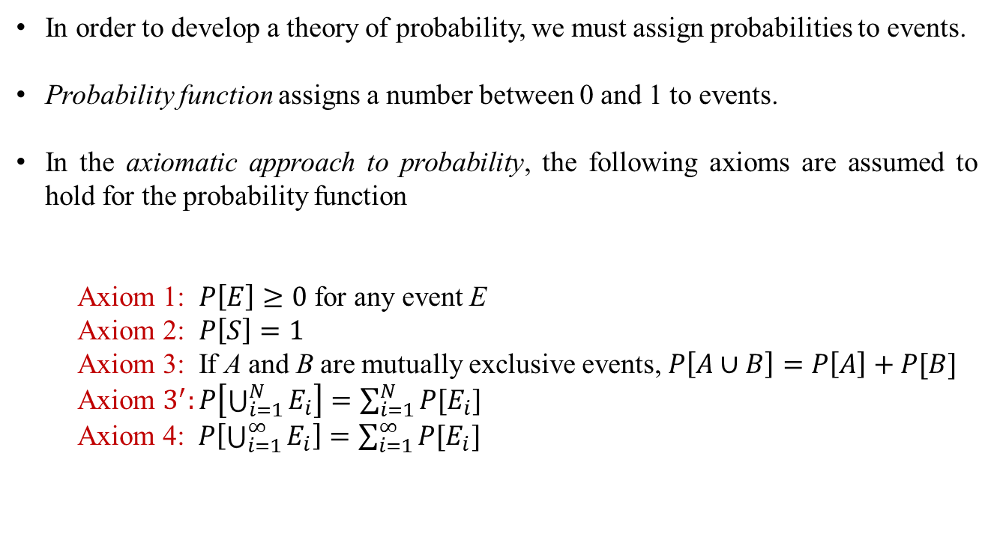
Assigning and Determining Probabilities
In order to develop a theory of probability, we must assign probabilities to events.
Probability function assigns a number between 0 and 1 to events.
In the axiomatic approach to probability, the following axioms are assumed to hold for the probability function
Axiom 1: $P\left[E\right]≥0$ for any event E
Axiom 2: $P\left[S\right]=1$
Axiom 3: If A and B are mutually exclusive events, $P\left[A∪B\right]=P\left[A\right]+P[B]$
Axiom $3^{′}:P\left[\bigcup_{i=1}^{N}{E_{i}}\right]=\sum_{i=1}^{N}{P[E_{i}]}$
Axiom 4: $P\left[\bigcup_{i=1}^{∞}{E_{i}}\right]=\sum_{i=1}^{∞}{P[E_{i}]}$

Slide 13
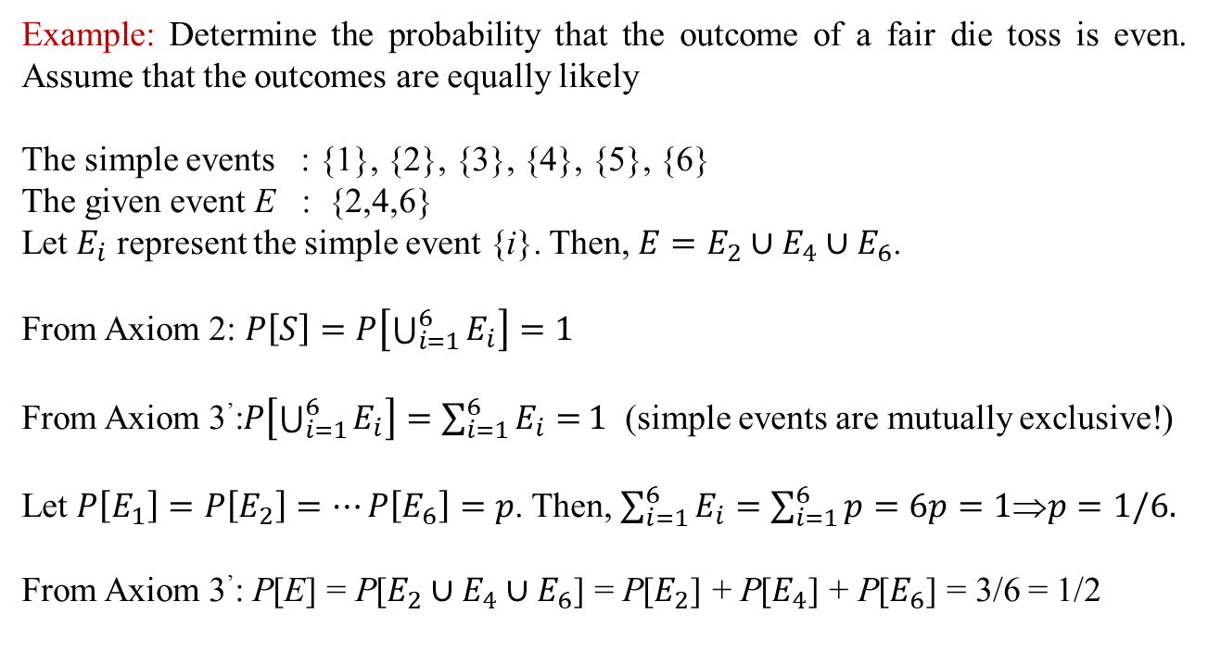
Assigning and Determining Probabilities
Example: Determine the probability that the outcome of a fair die toss is even. Assume that the outcomes are equally likely
The simple events : {1}, {2}, {3}, {4}, {5}, {6}
The given event E : {2,4,6}
Let $E_{i}$ represent the simple event {i}. Then, $E=E_{2}∪E_{4}∪E_{6}$.
From Axiom 2: $P\left[S\right]=P\left[\bigcup_{i=1}^{6}{E_{i}}\right]=1$
From Axiom 3’:$P\left[\bigcup_{i=1}^{6}{E_{i}}\right]=\sum_{i=1}^{6}{E_{i}=}1$ (simple events are mutually exclusive!)
Let $P\left[E_{1}\right]=P\left[E_{2}\right]=⋯P\left[E_{6}\right]=p$. Then, $\sum_{i=1}^{6}{E_{i}=\sum_{i=1}^{6}{p=6p}}=1⇒p=1/6.$
From Axiom 3’: P[E] = P[$E_{2}∪E_{4}∪E_{6}$] = P[$E_{2}$] + P[$E_{4}$] + P[$E_{6}$] = 3/6 = 1/2

Slide 14
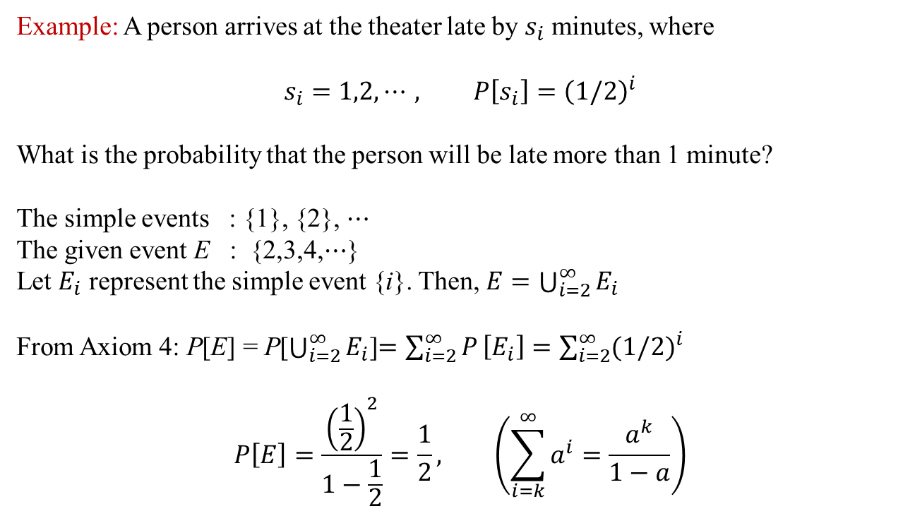
Assigning and Determining Probabilities
Example: A person arrives at the theater late by $s_{i}$ minutes, where
$$s_{i}=1,2,⋯, P\left[s_{i}\right]={\left(1/2\right)}^{i}$$
What is the probability that the person will be late more than 1 minute?
The simple events : {1}, {2}, $⋯$
The given event E : {2,3,4,$⋯$}
Let $E_{i}$ represent the simple event {i}. Then, $E=\bigcup_{i=2}^{∞}{E_{i}}$
From Axiom 4: P[E] = P[$\bigcup_{i=2}^{∞}{E_{i}}$]$=\sum_{i=2}^{∞}{P}\left[E_{i}\right]=\sum_{i=2}^{∞}{{(1/2)}^{i}}$
$$P\left[E\right]=\frac{{\left(\frac{1}{2}\right)}^{2}}{1−\frac{1}{2}}=\frac{1}{2}, \left(\sum_{i=k}^{∞}{a^{i}=\frac{a^{k}}{1−a}}\right)$$

Slide 15
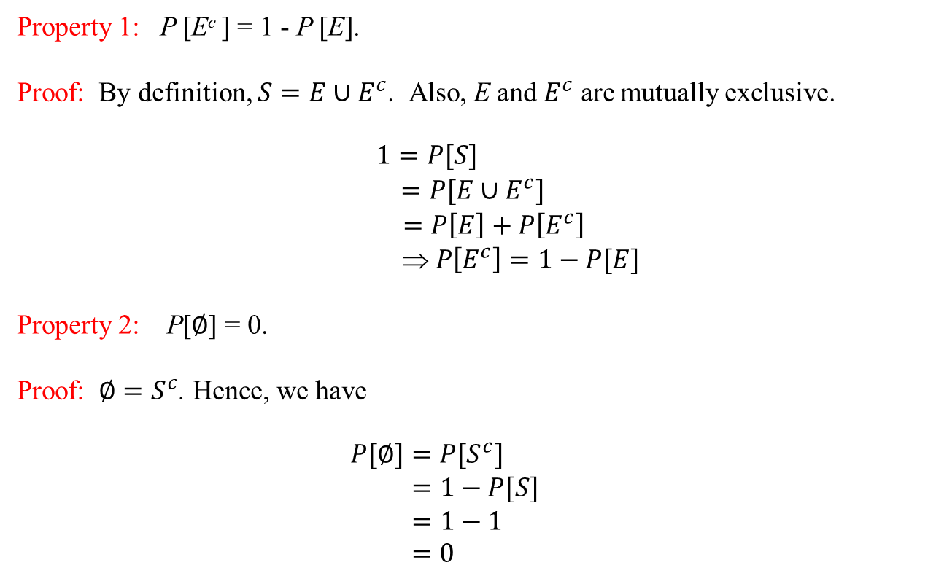
Properties of the Probability Function
Property 1: P [E^{c} ] = 1 - P [E].
Proof: By definition, $S=E∪E^{c}$. Also, E and $E^{c}$ are mutually exclusive.
$$\begin{matrix}1=P[S] \\ =P[E∪E^{c}] \\ \begin{aligned} =P\left[E\right]+P\left[E^{c}\right] \\  P\left[E^{c}\right]=1−P[E]\end{aligned}\end{matrix}$$
Property 2: P[$∅$] = 0.
Proof: $∅=S^{c}$. Hence, we have
$$\begin{matrix}P[∅]=P[S^{c}] \\ =1−P[S] \\ \begin{aligned} =1−1 \\ =0\end{aligned}\end{matrix}$$

Slide 16
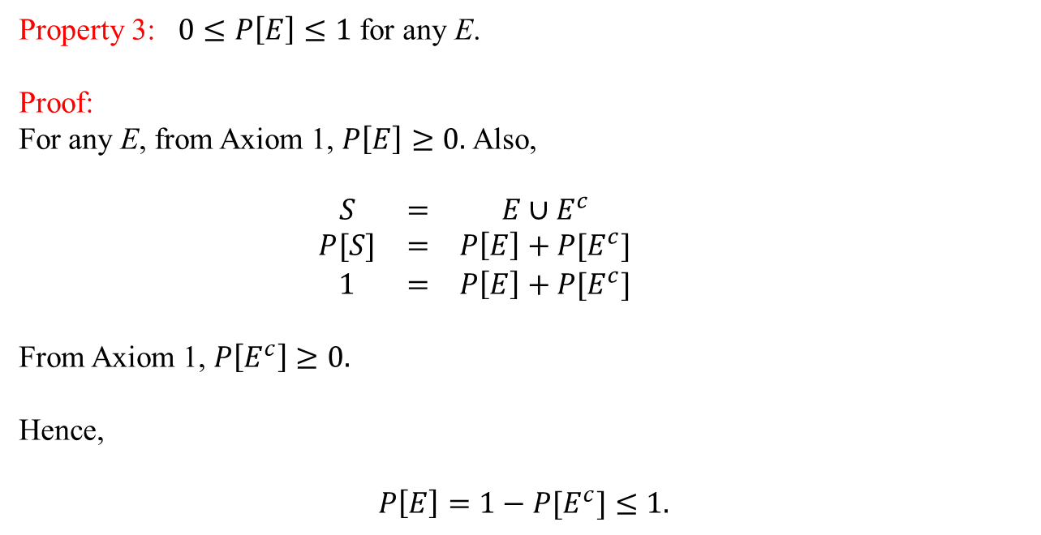
Properties of the Probability Function
Property 3: $0≤P\left[E\right]≤1$ for any E.
Proof:
For any E, from Axiom 1, $P\left[E\right]≥0.$ Also,
$$\begin{matrix}S & = & E∪E^{c} \\ P[S] & = & P\left[E\right]+P[E^{c}] \\ 1 & = & P\left[E\right]+P[E^{c}]\end{matrix}$$
From Axiom 1, $P\left[E^{c}\right]≥0.$
Hence,
$P\left[E\right]=1−P[E^{c}]≤1.$

Slide 17
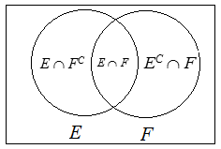
Properties of the Probability Function
Property 4: P [E ∪ F] = P [E] + P [F] – P [E ∩ F]
Proof:
P [E ∪ F] = P [E ∩ F^{C} ] + P [E ∩ F] + P [E^{C} ∩ F]
P[E] = P [E ∩ F^{C} ] + P [E ∩ F] ⇒ P [E ∩ F^{C} ] = P [E] – P [E ∩ F]
P [F] = P [F ∩ E^{C} ] + P [E ∩ F] ⇒ P [F ∩ E^{C} ] = P [F] – P [E ∩ F]
P [E ∪ F] = P [E] – P [E ∩ F] + P [E ∩ F] + P [F] – P [E ∩ F]
= P [E] + P [F] – P [E ∩ F]

Slide 18
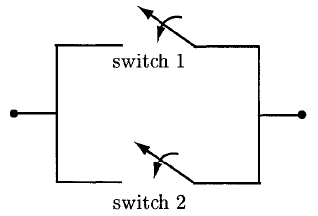
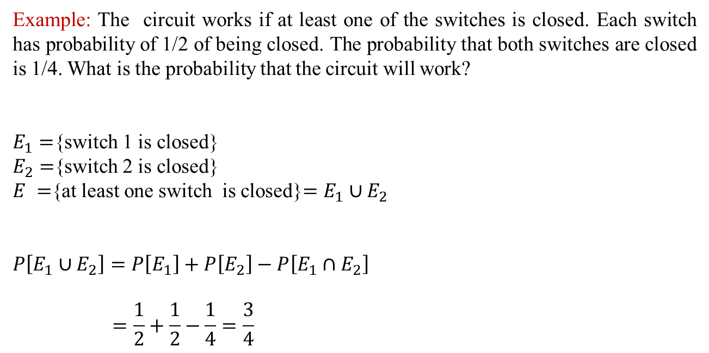
Properties of the Probability Function
Example: The circuit works if at least one of the switches is closed. Each switch has probability of 1/2 of being closed. The probability that both switches are closed is 1/4. What is the probability that the circuit will work?
$E_{1}=${switch 1 is closed}
$E_{2}=${switch 2 is closed}
$E =${at least one switch is closed}$=E_{1}∪E_{2}$
$$P\left[E_{1}∪E_{2}\right]=P\left[E_{1}\right]+P\left[E_{2}\right]−P\left[E_{1}∩E_{2}\right]$$
$$=\frac{1}{2}+\frac{1}{2}−\frac{1}{4}=\frac{3}{4}$$
Figure source: S. M. Kay, Intuitive Probabilty and Random Processes Using MATLAB, Prentice Hall, 2006.

Slide 19
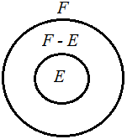
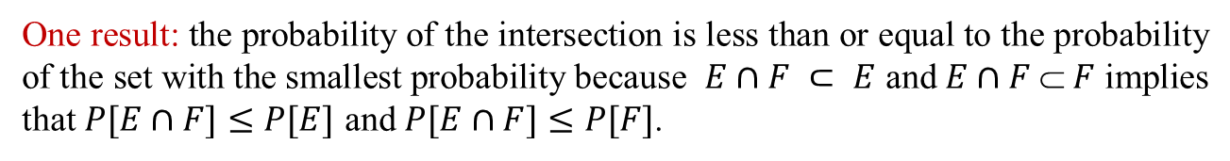
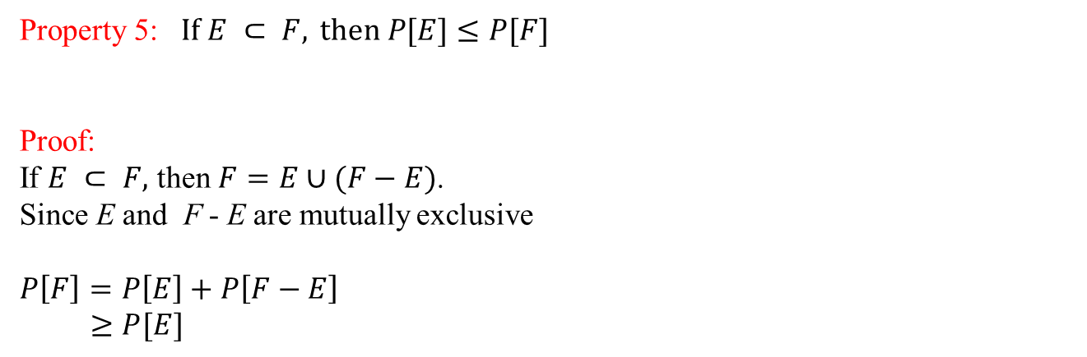
Properties of the Probability Function
Property 5: $\text{If} E ⊂ F, \text{then} P[E]≤P[F]$
Proof:
If $E ⊂ F,$ then $F=E∪(F−E)$.
Since E and F - E are mutually exclusive
$$P\left[F\right]=P\left[E\right]+P\left[F−E\right]$$
$≥P[E]$
One result: the probability of the intersection is less than or equal to the probability of the set with the smallest probability because $E∩F ⊂ E$ and $E∩F  F$ implies that $P[E∩F]≤P[E]$ and $P[E∩F]≤P[F]$.

Slide 20

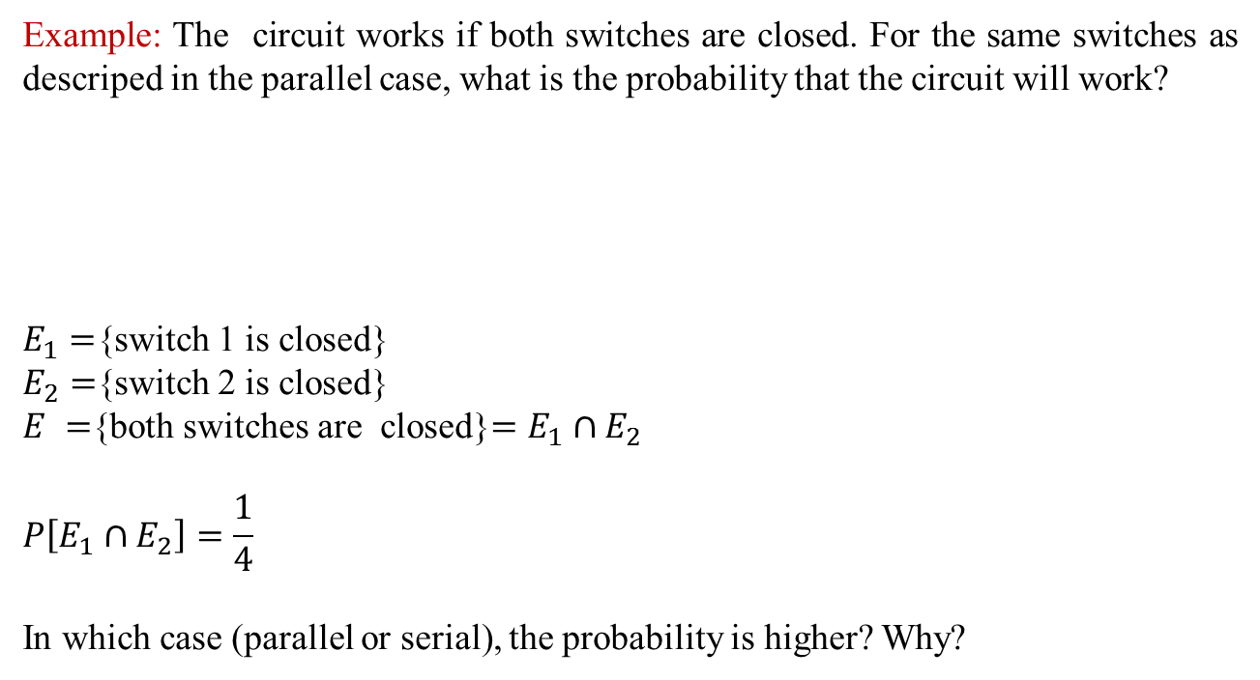
Properties of the Probability Function
Example: The circuit works if both switches are closed. For the same switches as descriped in the parallel case, what is the probability that the circuit will work?
$E_{1}=${switch 1 is closed}
$E_{2}=${switch 2 is closed}
$E =${both switches are closed}$=E_{1}∩E_{2}$
$$P\left[E_{1}∩E_{2}\right]=\frac{1}{4}$$
In which case (parallel or serial), the probability is higher? Why?
Figure source: S. M. Kay, Intuitive Probabilty and Random Processes Using MATLAB, Prentice Hall, 2006.

Slide 21
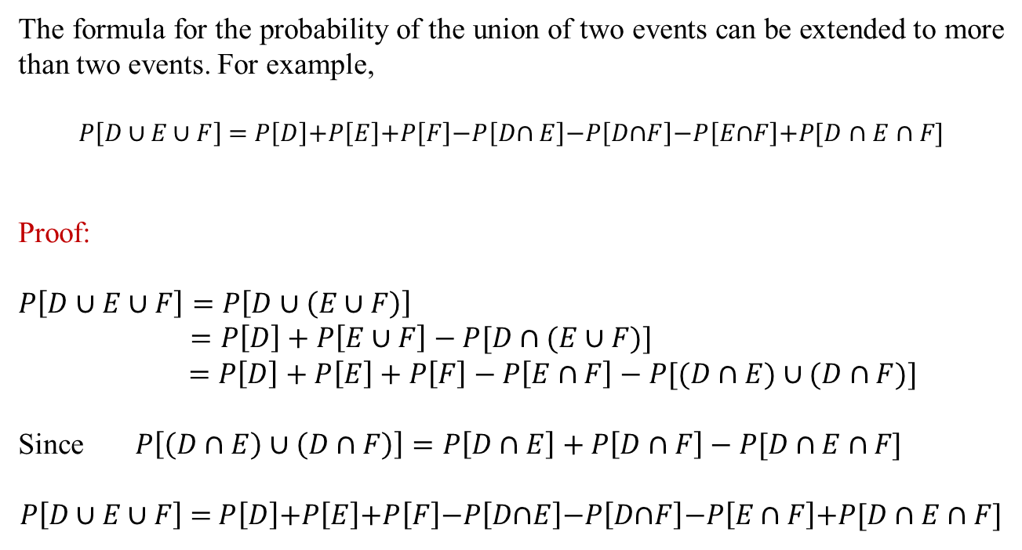
Properties of the Probability Function
The formula for the probability of the union of two events can be extended to more than two events. For example,
$$P\left[D \text{∪ }E\text{ ∪ }F\right] \text{=} P\left[D\right]\text{+}P\left[E\right]\text{+}P\left[F\right]\text{−}P\left[D\text{∩ }E\right]\text{−}P\left[D\text{∩}F\right]\text{−}P\left[E\text{∩}F\right]\text{+}P\text{[}D∩E∩F\text{]}$$
Proof:
$$P\left[D∪E∪F\right]=P\left[D∪\left(E∪F\right)\right]$$
$=P\left[D\right]+P\left[E∪F\right]−P[D∩(E∪F)]$
$$=P\left[D\right]+P\left[E\right]+P\left[F\right]−P\left[E∩F\right]−P[(D∩E)∪(D∩F)]$$
Since $P\left[\left(D∩E\right)∪\left(D∩F\right)\right]=P\left[D∩E\right]+P\left[D∩F\right]−P\text{[}D∩E∩F\text{]}$
$$P\left[D \text{∪ }E\text{ ∪ }F\right] \text{=} P\left[D\right]\text{+}P\left[E\right]\text{+}P\left[F\right]\text{−}P\left[D\text{∩}E\right]\text{−}P\left[D\text{∩}F\right]\text{−}P\left[E \text{∩ }F\right]\text{+}P\text{[}D∩E∩F]$$

Slide 22
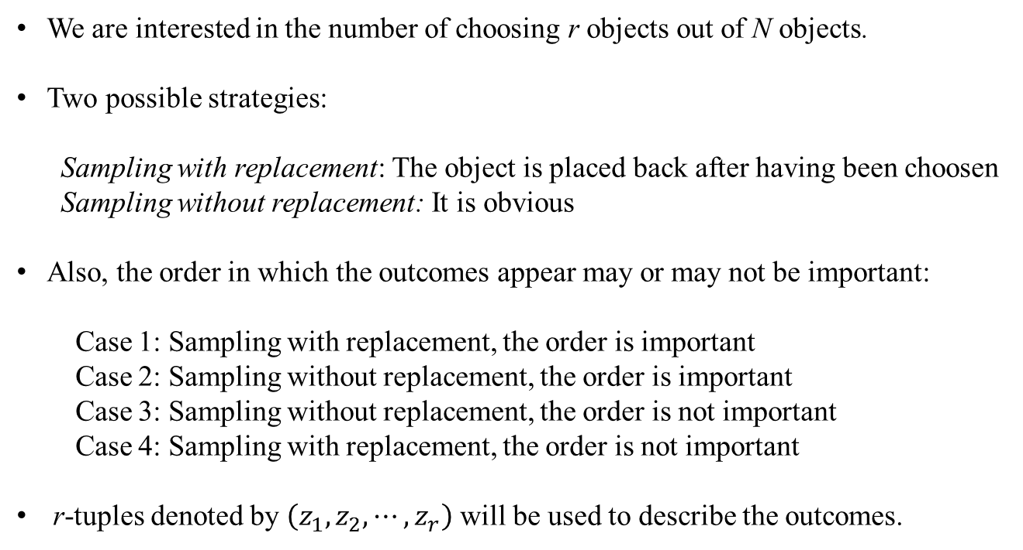
Counting Methods
We are interested in the number of choosing r objects out of N objects.
Two possible strategies:
Sampling with replacement: The object is placed back after having been choosen
Sampling without replacement: It is obvious
Also, the order in which the outcomes appear may or may not be important:
Case 1: Sampling with replacement, the order is important
Case 2: Sampling without replacement, the order is important
Case 3: Sampling without replacement, the order is not important
Case 4: Sampling with replacement, the order is not important
r-tuples denoted by $\left(z_{1},z_{2},⋯,z_{r}\right)$ will be used to describe the outcomes.

Slide 23
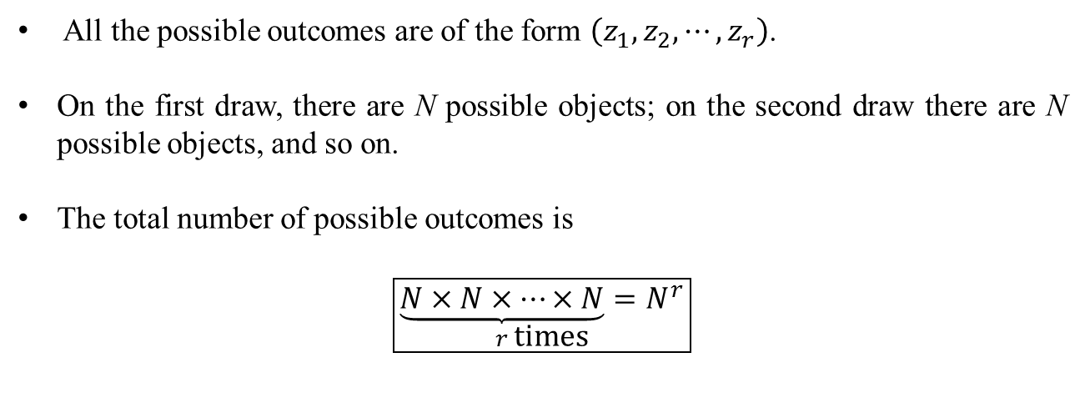
Counting Methods
Counting Methods
Case 1: Sampling with replacement, the order is important
All the possible outcomes are of the form $\left(z_{1},z_{2},⋯,z_{r}\right)$.
On the first draw, there are N possible objects; on the second draw there are N possible objects, and so on.
The total number of possible outcomes is
$$\boxed{\underset{r \text{times}}{\underbrace{N×N×⋯×N}=N^{r}}}$$

Slide 24
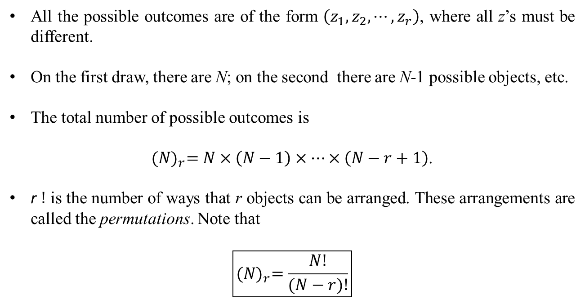
Counting Methods
Case 2: Sampling without replacement, the order is important
All the possible outcomes are of the form $\left(z_{1},z_{2},⋯,z_{r}\right)$, where all z’s must be different.
On the first draw, there are N; on the second there are N-1 possible objects, etc.
The total number of possible outcomes is
${(N)}_{r}=N×\left(N−1\right)×⋯×\left(N−r+1\right)$.
r $!$ is the number of ways that r objects can be arranged. These arrangements are called the permutations. Note that
$$\boxed{{(N)}_{r}=\frac{N!}{(N−r)!}}$$

Slide 25
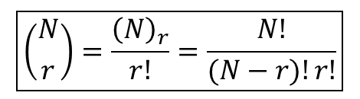
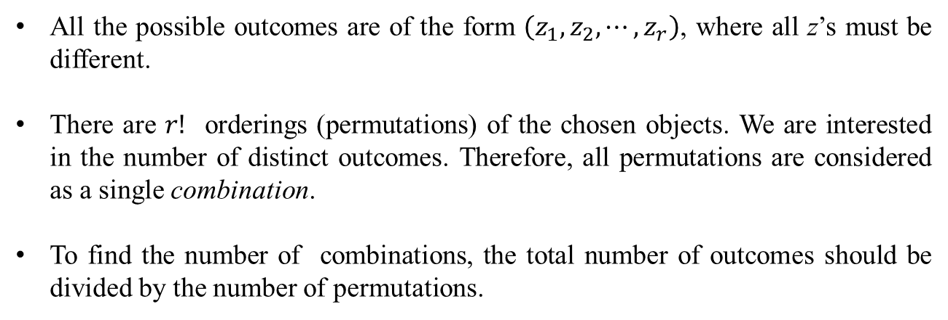
Counting Methods
Case 3: Sampling without replacement, the order is not important
All the possible outcomes are of the form $\left(z_{1},z_{2},⋯,z_{r}\right)$, where all z’s must be different.
There are $r!$ orderings (permutations) of the chosen objects. We are interested in the number of distinct outcomes. Therefore, all permutations are considered as a single combination.
To find the number of combinations, the total number of outcomes should be divided by the number of permutations.
$$\boxed{\left({N \atop r}\right)=\frac{{\left(N\right)}_{r}}{r!}=\frac{N!}{(N−r)!r!}}$$

Slide 26
Counting Methods
Case 4: Sampling with replacement, the order is not important
In order to show this case, we can form a table with one row whose columns separated by the symbol / correspond to an object. In a given draw, we place an x in the column corresponding to the object drawn.
For example, consider the case of drawing 4 objects from 3 distinct objects with replacement. One possible outcome is
Object 1 Object 2 Object 3
xx / / xx
In other words, object 2 is not selected, objects 1 and 2 are selected twice. We can show this particular case with xx//xx.

Slide 27
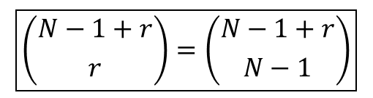
Counting Methods
In the general case case, the numbers of / and x will be N-1 and r, respectively.
The problem is then is reduced to choosing r (if x is considered) or N - 1 (if / is considered) objects out of N – 1 + r objects (the order is not important)
We know that the result can be calculated by the combination:
$$\boxed{\left({N−1+r \atop r}\right)=\left({N−1+r \atop N−1}\right)}$$

Slide 28
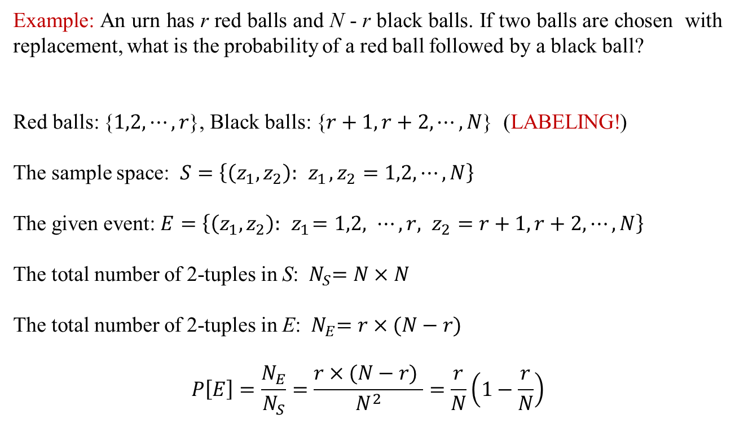
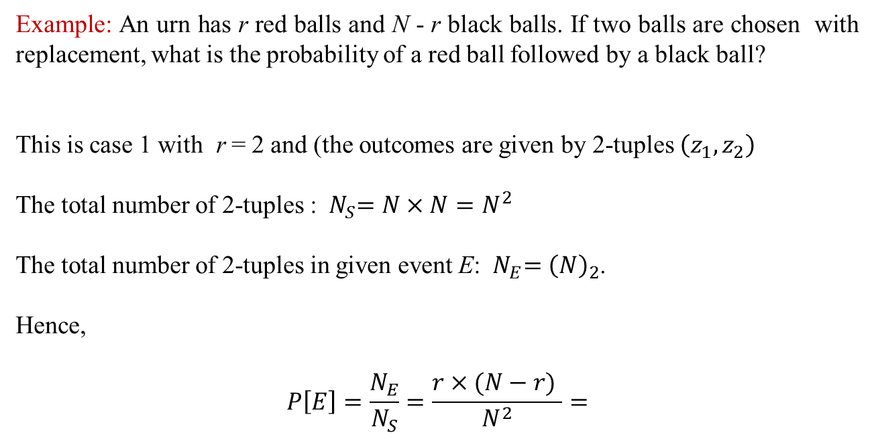
Counting Methods
Example: An urn has r red balls and N - r black balls. If two balls are chosen with replacement, what is the probability of a red ball followed by a black ball?
This is case 1 with r = 2 and (the outcomes are given by 2-tuples $\left(z_{1},z_{2}\right)$
The total number of 2-tuples : ${ N}_{S}=N×N=N^{2}$
The total number of 2-tuples in given event E: ${ N}_{E}={\left(N\right)}_{2}$.
Hence,
$$P\left[E\right]=\frac{N_{E}}{N_{S}}=\frac{r×(N−r) }{N^{2}}=$$
Example: An urn has r red balls and N - r black balls. If two balls are chosen with replacement, what is the probability of a red ball followed by a black ball?
Red balls: {$1,2,⋯,r$}, Black balls: {$r+1,r+2,⋯,N$} (LABELING!)
The sample space: $S=\left\{\left(z_{1},z_{2}\right):{ z}_{1},z_{2}=1,2,⋯,N\right\}$
The given event: $E=\left\{\left(z_{1},z_{2}\right):{ z}_{1}=1,2, ⋯,r, z_{2}=r+1,r+2,⋯,N\right\}$
The total number of 2-tuples in S: ${ N}_{S}=N×N$
The total number of 2-tuples in E: ${ N}_{E}=r×(N−r)$
$$P\left[E\right]=\frac{N_{E}}{N_{S}}=\frac{r×(N−r) }{N^{2}}=\frac{r}{N}\left(1−\frac{r}{N}\right)$$

Slide 29
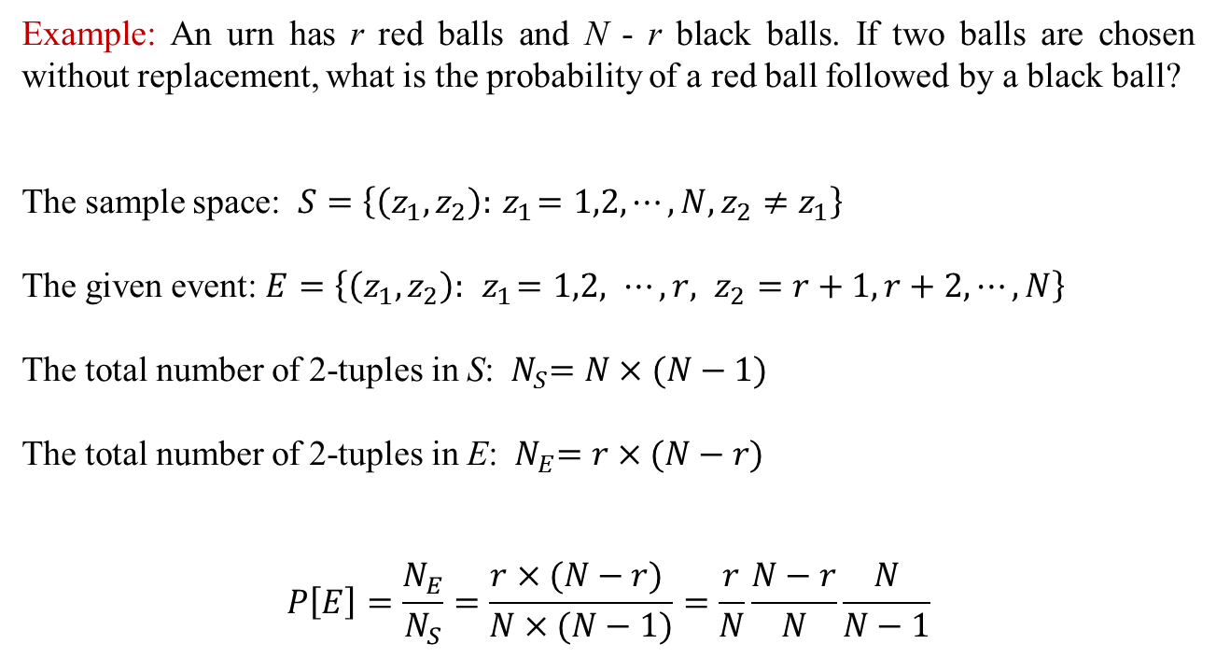
Counting Methods
Example: An urn has r red balls and N - r black balls. If two balls are chosen without replacement, what is the probability of a red ball followed by a black ball?
The sample space: $S=\left\{\left(z_{1},z_{2}\right):{ z}_{1}=1,2,⋯,N, z_{2}≠z_{1}\right\}$
The given event: $E=\left\{\left(z_{1},z_{2}\right):{ z}_{1}=1,2, ⋯,r, z_{2}=r+1,r+2,⋯,N\right\}$
The total number of 2-tuples in S: ${ N}_{S}=N×(N−1)$
The total number of 2-tuples in E: ${ N}_{E}=r×(N−r)$
$$P\left[E\right]=\frac{N_{E}}{N_{S}}=\frac{r×(N−r) }{N×(N−1)}=\frac{r}{N}\frac{N−r}{N}\frac{N}{N−1}$$

Slide 30
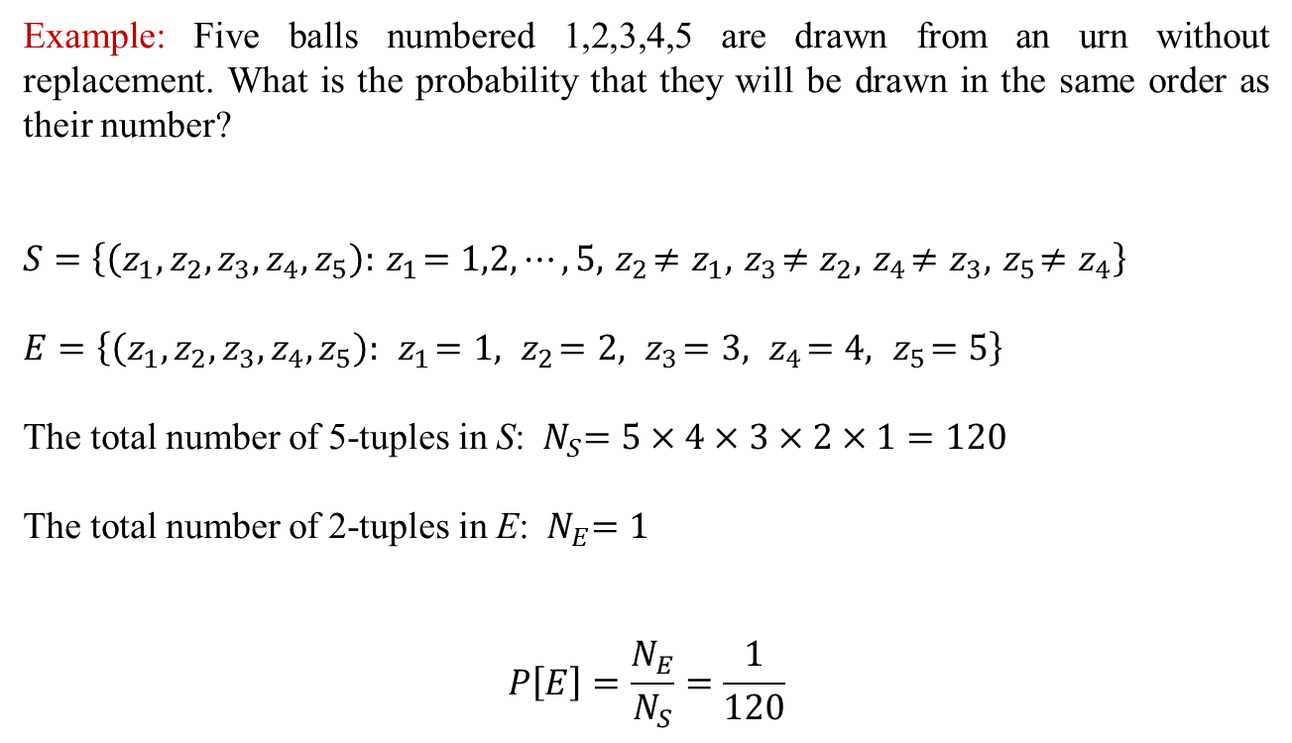
Counting Methods
Example: Five balls numbered 1,2,3,4,5 are drawn from an urn without replacement. What is the probability that they will be drawn in the same order as their number?
$$S=\left\{\left(z_{1},z_{2},z_{3},z_{4},z_{5}\right):{ z}_{1}=1,2,⋯,5, { z}_{2}≠z_{1},{ z}_{3}≠z_{2}, { z}_{4}≠z_{3},{ z}_{5}≠z_{4}\right\}$$
$$E=\left\{\left(z_{1},z_{2},z_{3},z_{4},z_{5}\right):{ z}_{1}=1,{ z}_{2}=2,{ z}_{3}=3,{ z}_{4}=4,{ z}_{5}=5\right\}$$
The total number of 5-tuples in S: ${ N}_{S}=5×4×3×2×1=120$
The total number of 2-tuples in E: ${ N}_{E}=1$
$$P\left[E\right]=\frac{N_{E}}{N_{S}}=\frac{1}{120}$$

Slide 31
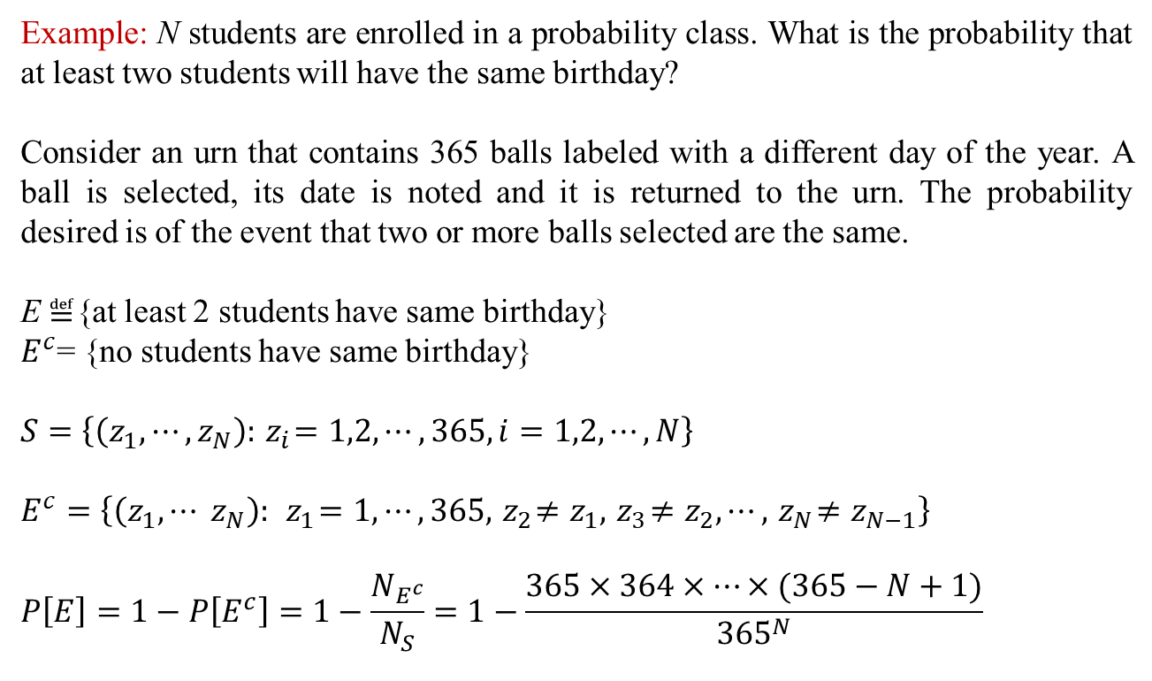
Counting Methods
Example: N students are enrolled in a probability class. What is the probability that at least two students will have the same birthday?
Consider an urn that contains 365 balls labeled with a different day of the year. A ball is selected, its date is noted and it is returned to the urn. The probability desired is of the event that two or more balls selected are the same.
E$≝${at least 2 students have same birthday}
$E^{c}$= {no students have same birthday}
$$S=\left\{\left(z_{1},⋯,z_{N}\right):{ z}_{i}=1,2,⋯,365, i=1,2,⋯,N\right\}$$
$$E^{c}=\left\{\left(z_{1},⋯ z_{N}\right):{ z}_{1}=1,⋯,365,{ z}_{2}≠z_{1},{ z}_{3}≠z_{2},⋯,{ z}_{N}≠z_{N−1}\right\}$$
$$P\left[E\right]=1−P\left[E^{c}\right]=1−\frac{N_{E^{c}}}{N_{S}}=1−\frac{365×364×⋯×(365−N+1)}{{365}^{N}}$$

Slide 32
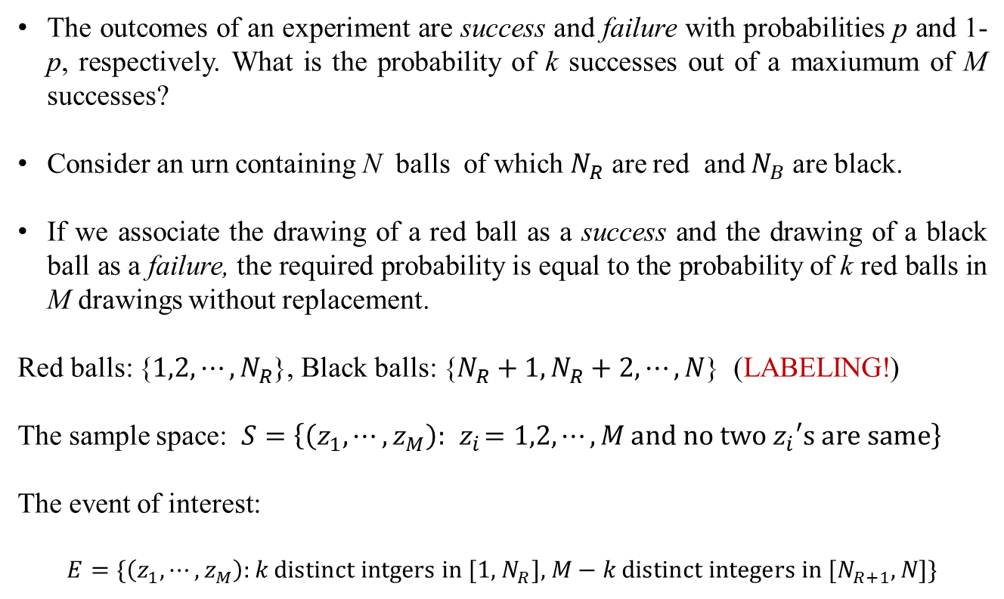
Binomial Probability Law
The outcomes of an experiment are success and failure with probabilities p and 1-p, respectively. What is the probability of k successes out of a maxiumum of M successes?
Consider an urn containing N balls of which $N_{R}$ are red and $N_{B}$ are black.
If we associate the drawing of a red ball as a success and the drawing of a black ball as a failure, the required probability is equal to the probability of k red balls in M drawings without replacement.
Red balls: {$1,2,⋯,N_{R}$}, Black balls: {$N_{R}+1,N_{R}+2,⋯,N$} (LABELING!)
The sample space: $S=\left\{\left(z_{1}, ⋯,z_{M}\right):{ z}_{i}=1,2,⋯,M \text{and} \text{no} \text{two} z_{i}\text{′}\text{s} \text{are} \text{same}\right\}$
The event of interest:
$$E=\{\left(z_{1}, ⋯,z_{M}\right):k \text{distinct} \text{intgers} \text{in}\text{ [1,}{ N}_{R}\text{], }M\text{ −} k \text{distinct} \text{integers} \text{in}\text{ [}N_{R+1}, N\text{]\}}$$

Slide 33
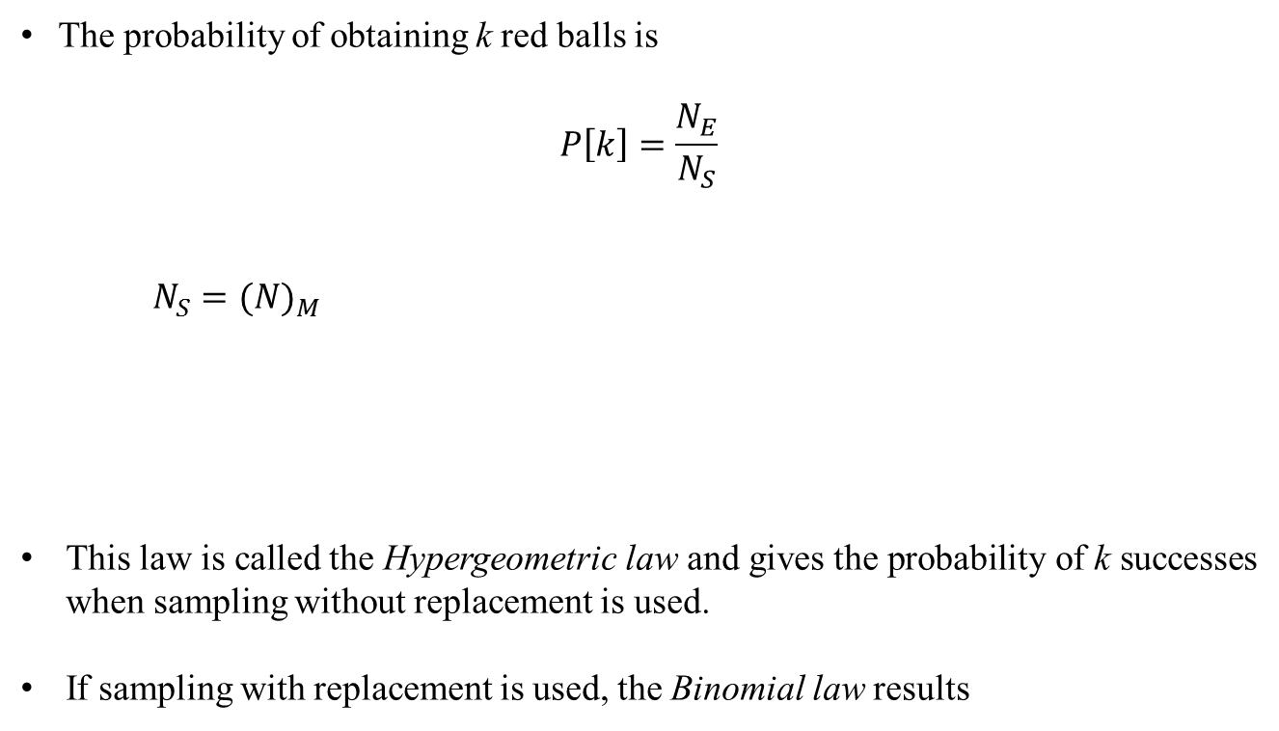
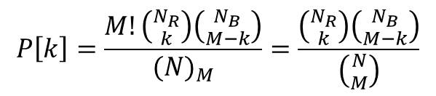
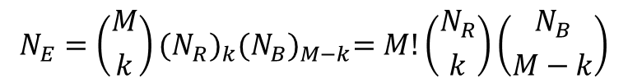
Binomial Probability Law
The probability of obtaining k red balls is
$$P\left[k\right]=\frac{N_{E}}{N_{S}}$$
$N_{S}={(N)}_{M}$
This law is called the Hypergeometric law and gives the probability of k successes when sampling without replacement is used.
If sampling with replacement is used, the Binomial law results
$$N_{E}=\left({M \atop k}\right){(N_{R})}_{k}{(N_{B})}_{M−k}=M!\left({N_{R} \atop k}\right)\left({N_{B} \atop M−k}\right)$$
$$P\left[k\right]=\frac{M!\left({N_{R} \atop k}\right)\left({N_{B} \atop M−k}\right)}{{(N)}_{M}}=\frac{\left({N_{R} \atop k}\right)\left({N_{B} \atop M−k}\right)}{\left({N \atop M}\right)}$$

Slide 34
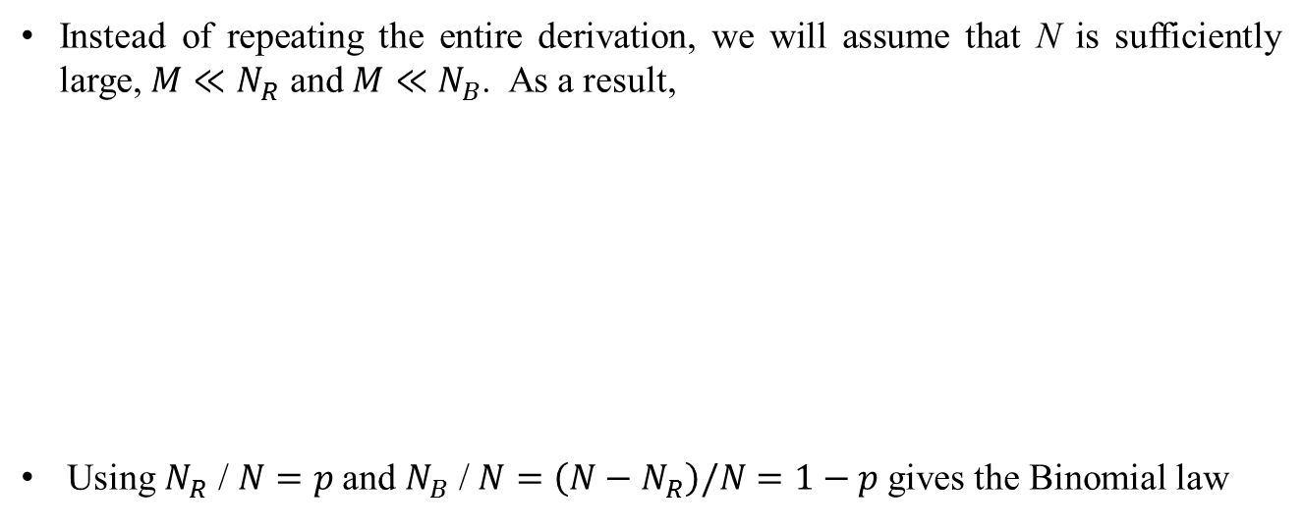
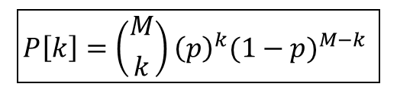
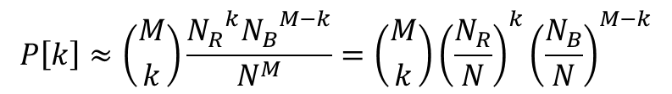
Binomial Probability Law
Instead of repeating the entire derivation, we will assume that N is sufficiently large, $M≪N_{R}$ and $M≪N_{B}$. As a result,
Using $N_{R}$ /$N=p$ and $N_{B}$ /$N=\left(N−N_{R}\right)\text{/}N=1−p$ gives the Binomial law
$${(N)}_{M}≈N^{M}, { \left(N_{R}\right)}_{k}≈{N_{R}}^{k}, { (N_{B})}_{M−k}≈{N_{B}}^{M−k}$$
$$P\left[k\right]≈\left({M \atop k}\right)\frac{{N_{R}}^{k}{N_{B}}^{M−k}}{N^{M}}=\left({M \atop k}\right){\left(\frac{N_{R}}{N}\right)}^{k}{\left(\frac{N_{B}}{N}\right)}^{M−k}$$
$$\boxed{P\left[k\right]=\left({M \atop k}\right){\left(p\right)}^{k}{(1−p)}^{M−k} }$$

Slide 35
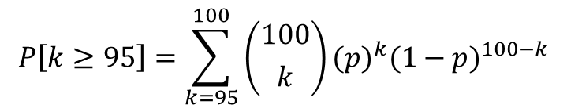
Real World Example: Quality Control
Example: A memory chip manufacturer produces batches of 1000 chips for shipment to computer companies. 100 chips selected at random from a batch are tested. If 95 or more chips pass the test, the batch is acceptable, otherwise it defective.
Let us assume that a chip passes the test with probability p. What is the probability that a given batch will be acceptable?
The batch will not be defective if there are 95 or more successes out of 100 drawing. The probability of this occuring is
$$P\left[k≥95\right]=\sum_{k=95}^{100}{\left({100 \atop k}\right)}{(p)}^{k}{(1−p)}^{100−k}$$

